Slide 1
Homework 2
Samer Baslan
CMPE-257: Deep Learning
Spring 2021

Slide 2
Image AutoML

Slide 3
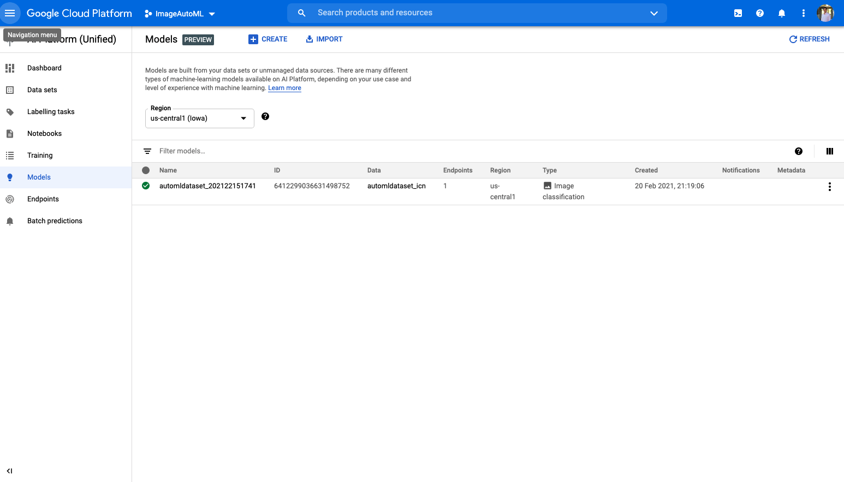
Model

Slide 4
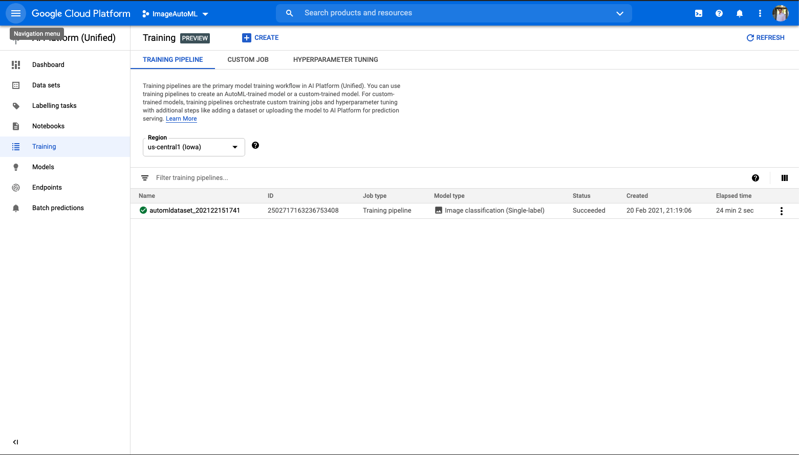
Training

Slide 5
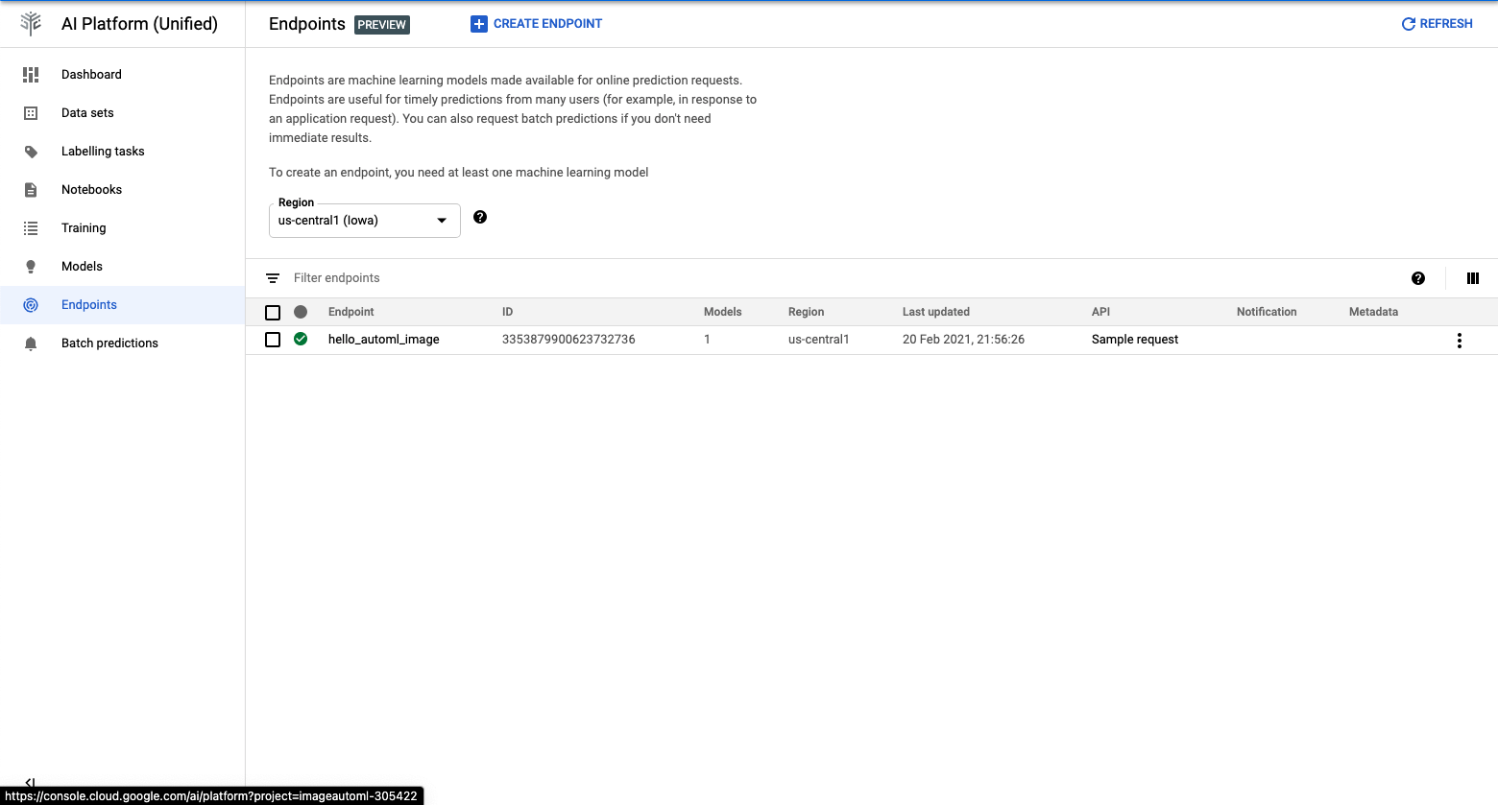
Endpoint

Slide 6
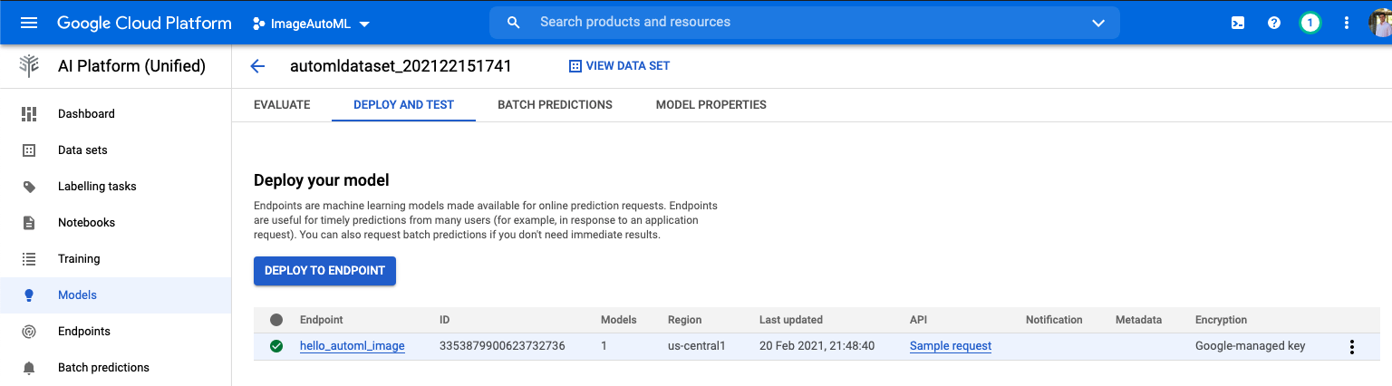
Deploy

Slide 7
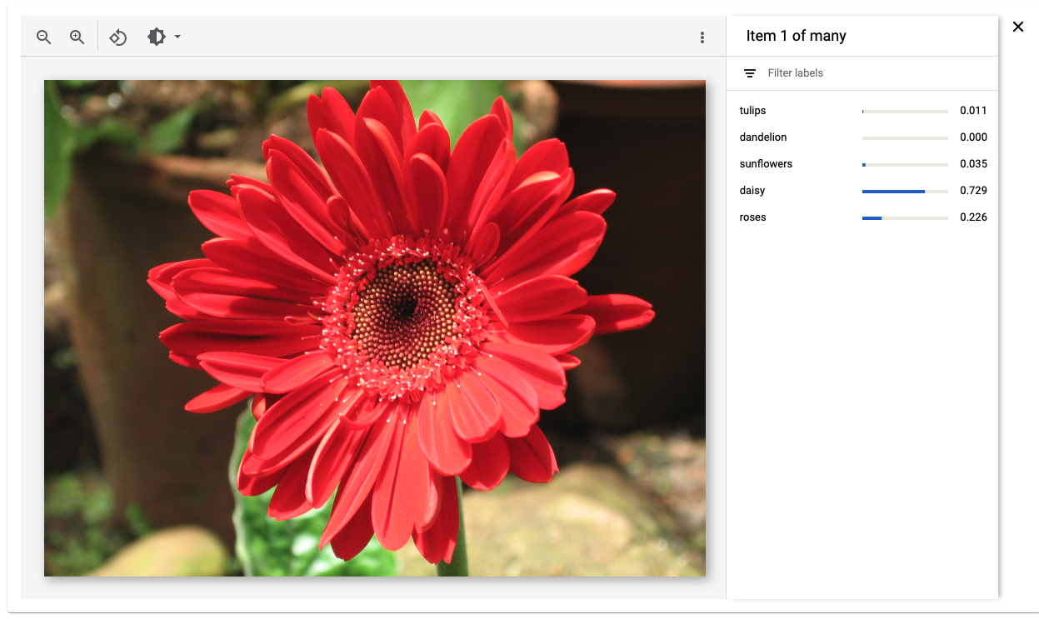
Test prediction

Slide 8
TextAutoML

Slide 9
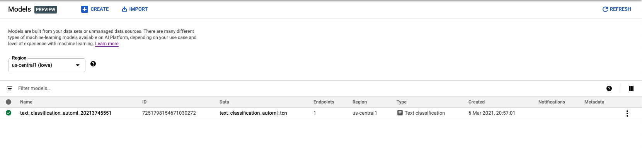
Model

Slide 10
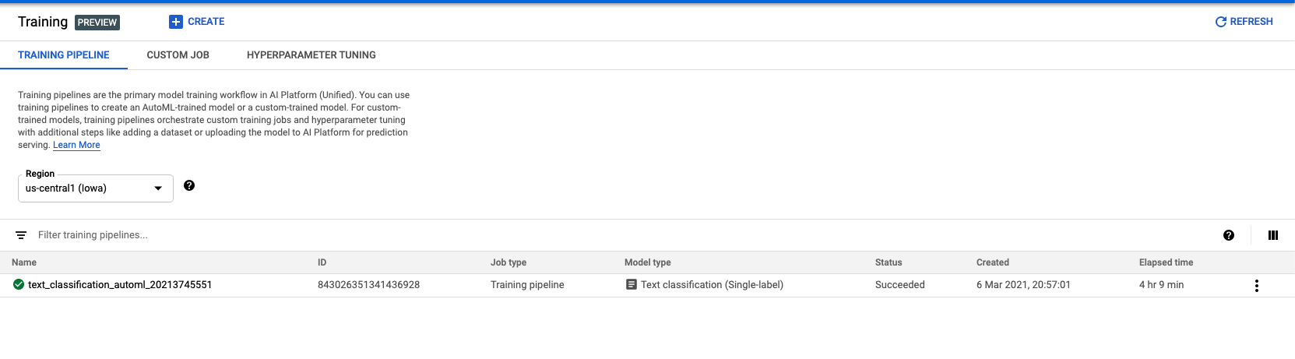
Training

Slide 11
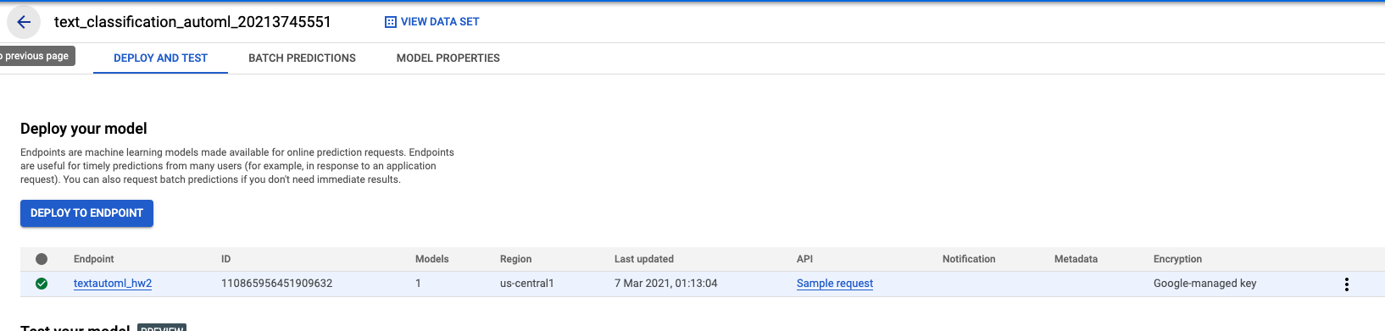
Deploy

Slide 12
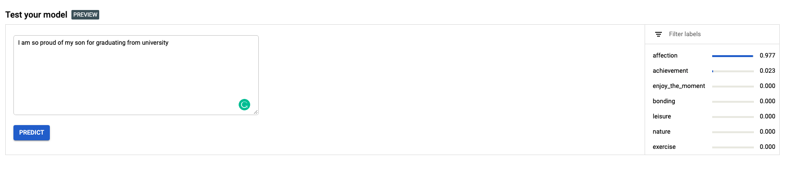
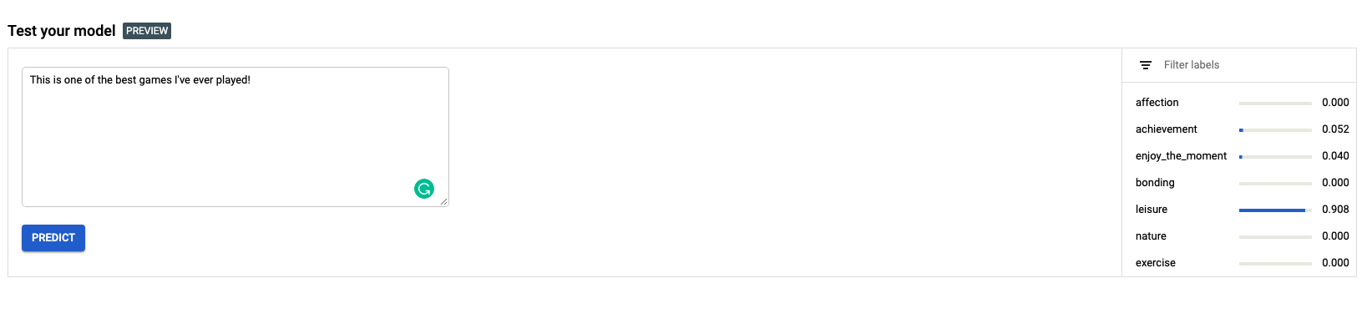
Test prediction

Slide 13
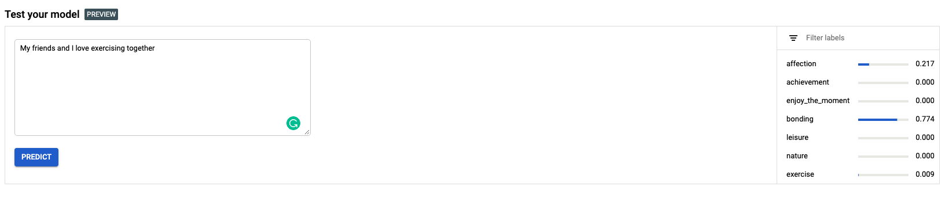
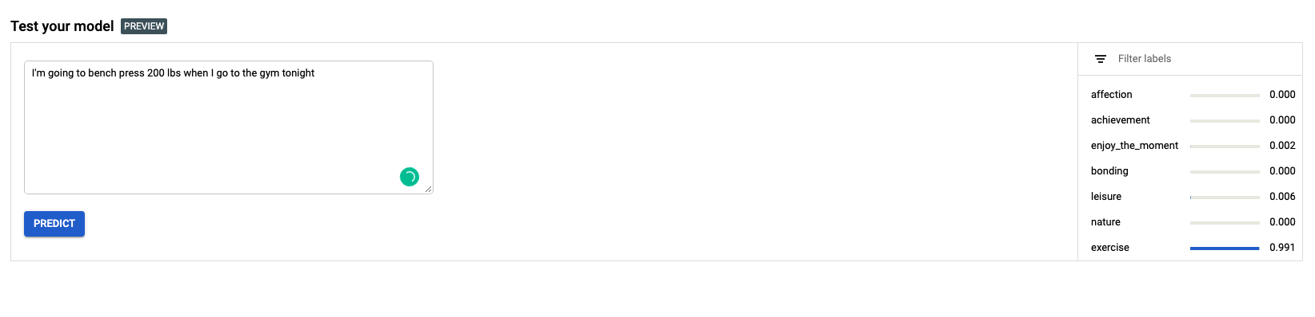
More testing

Slide 14
VideoAutoML

Slide 15

Dataset

Slide 16

Training

Slide 17
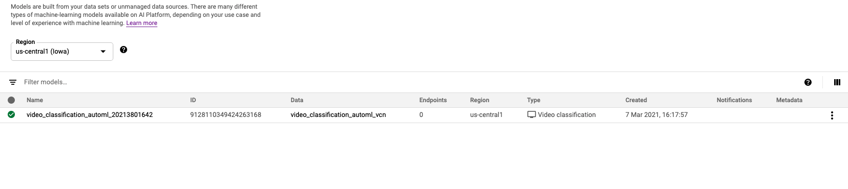
Model

Slide 18
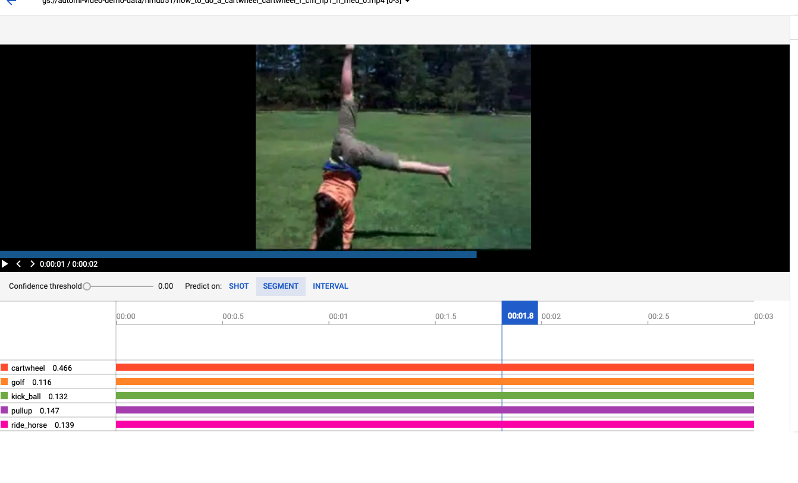
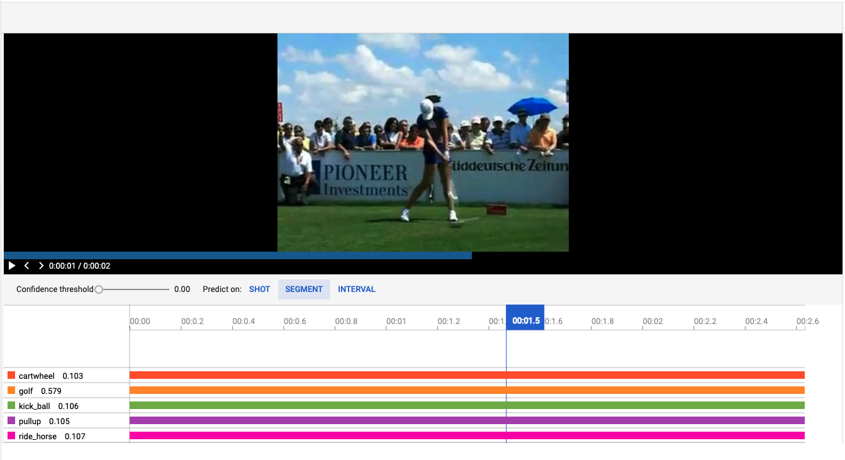
Test predictions

Slide 19
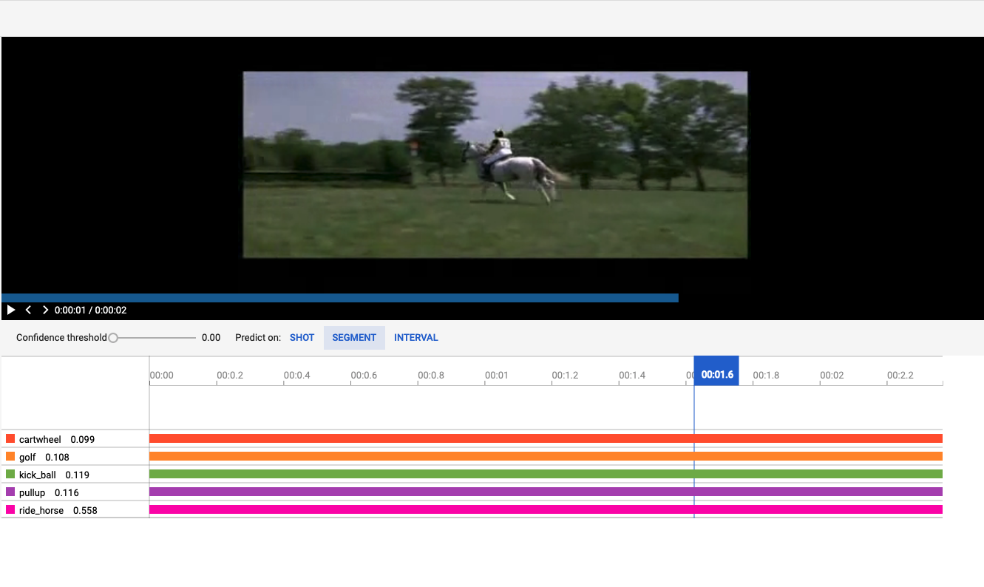
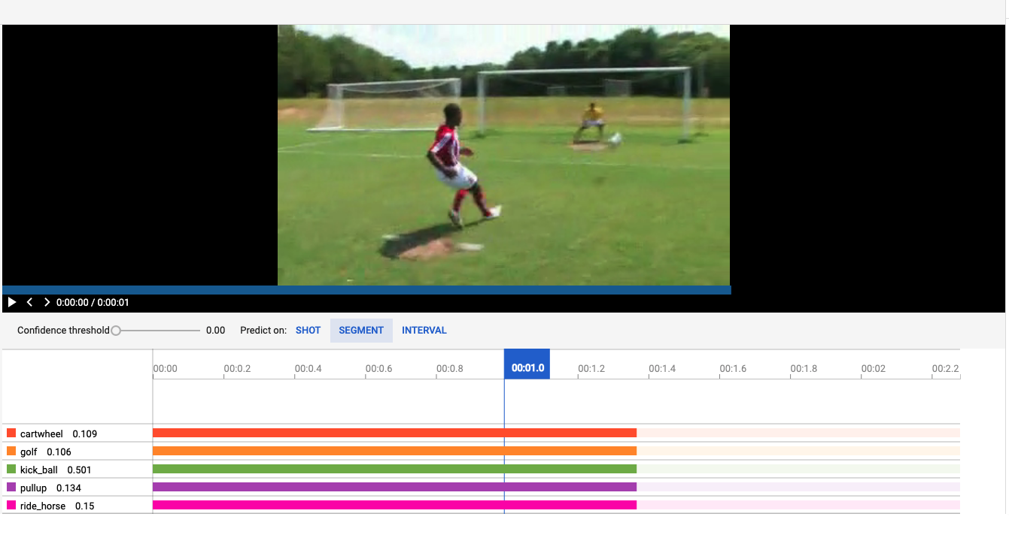
Test predictions

Slide 20
Custom AutoML

Slide 21
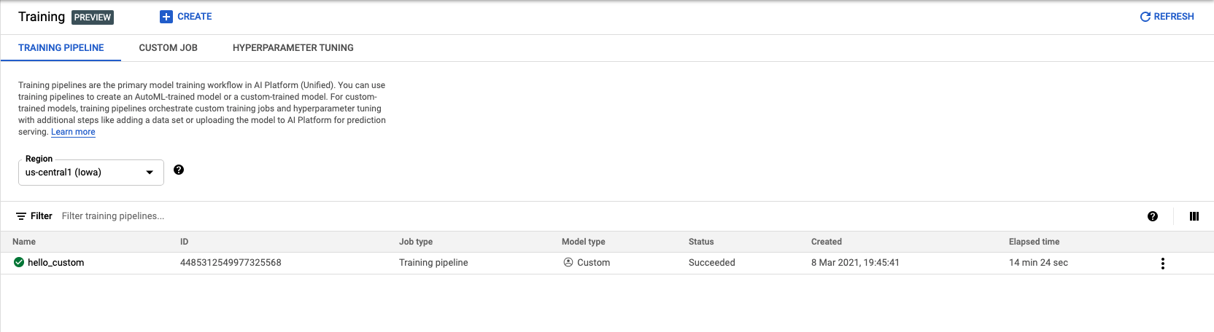
Training

Slide 22
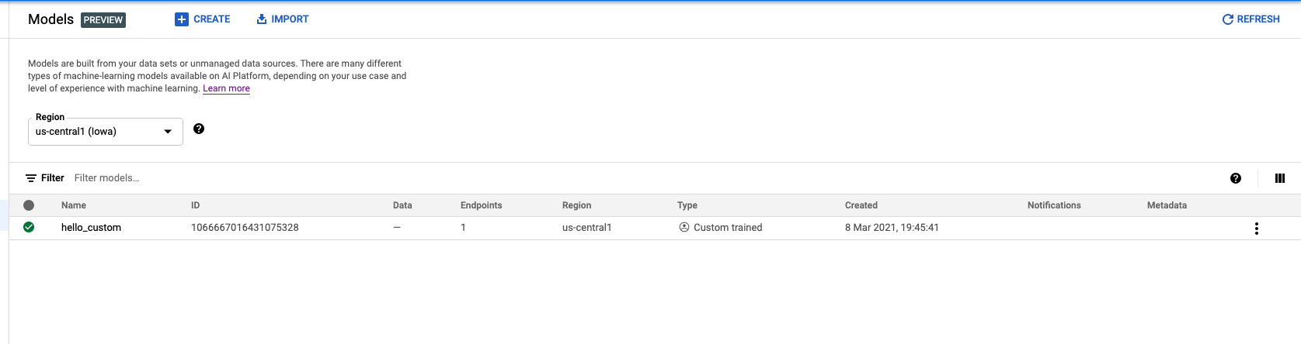
Model

Slide 23
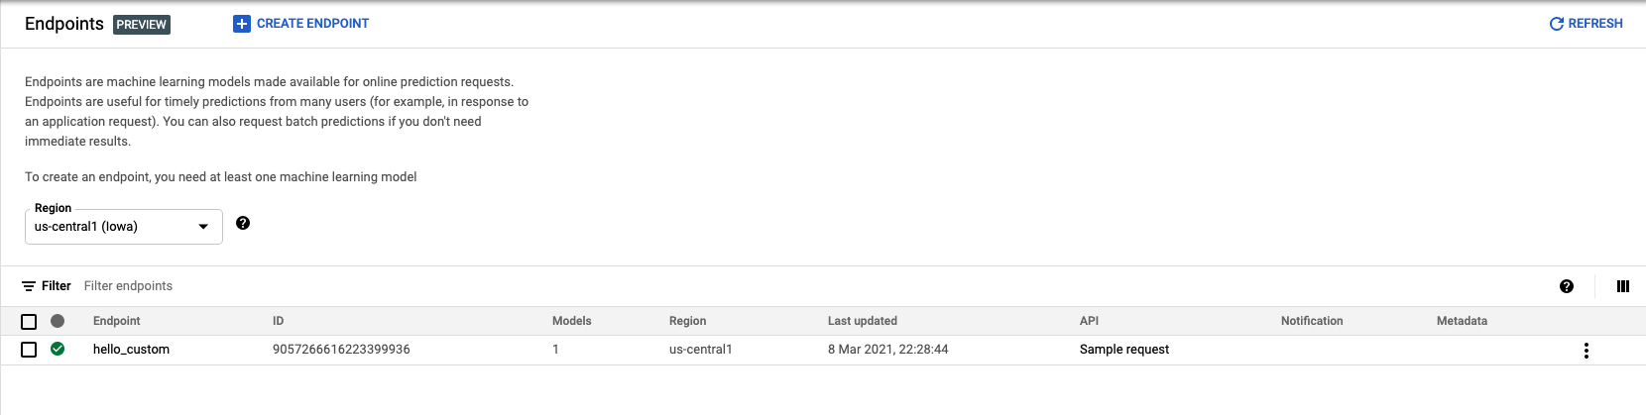
Endpoint

Slide 24
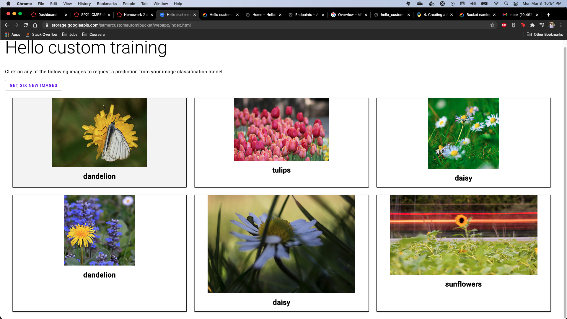
Deployment

Slide 25
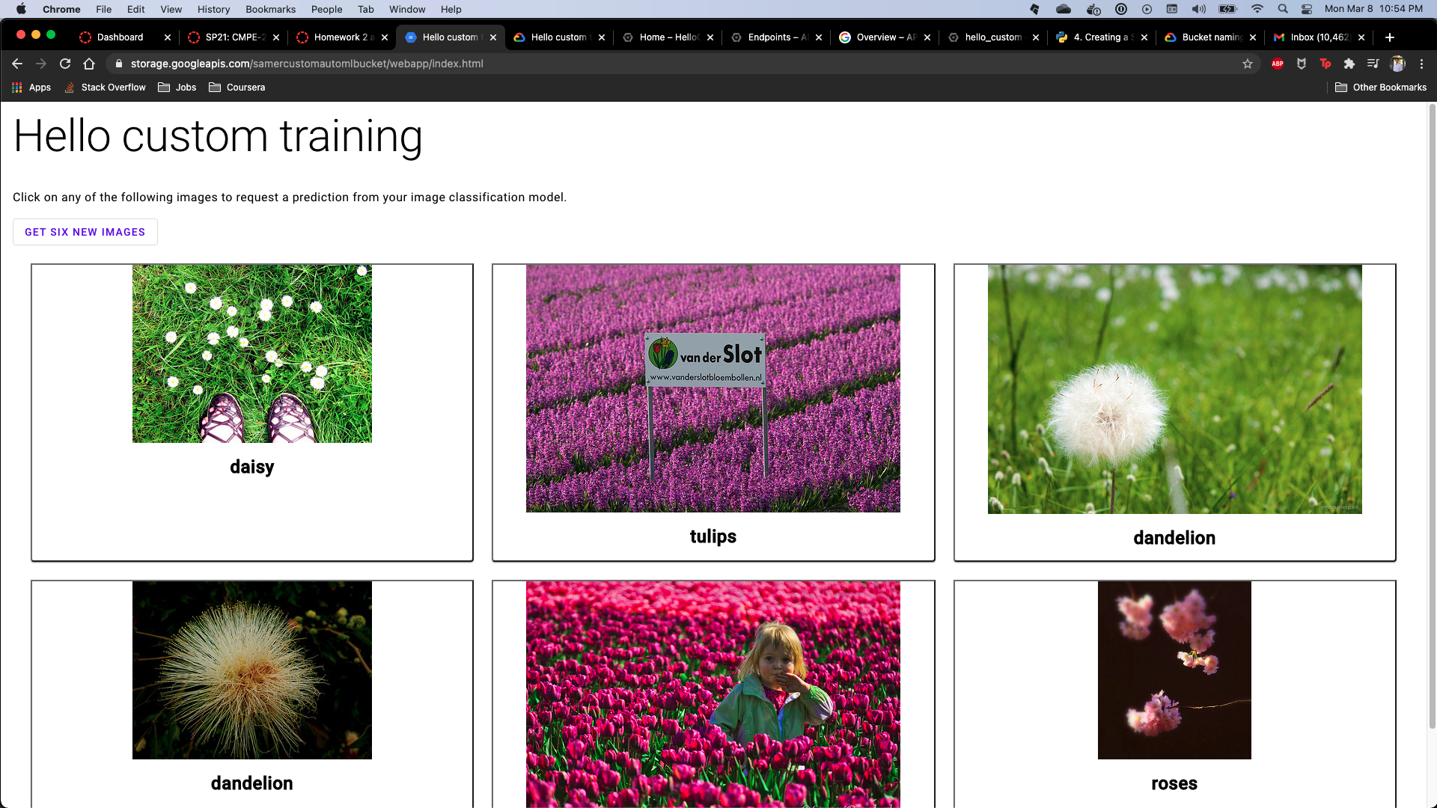

Slide 26
TabularAutoML

Slide 27
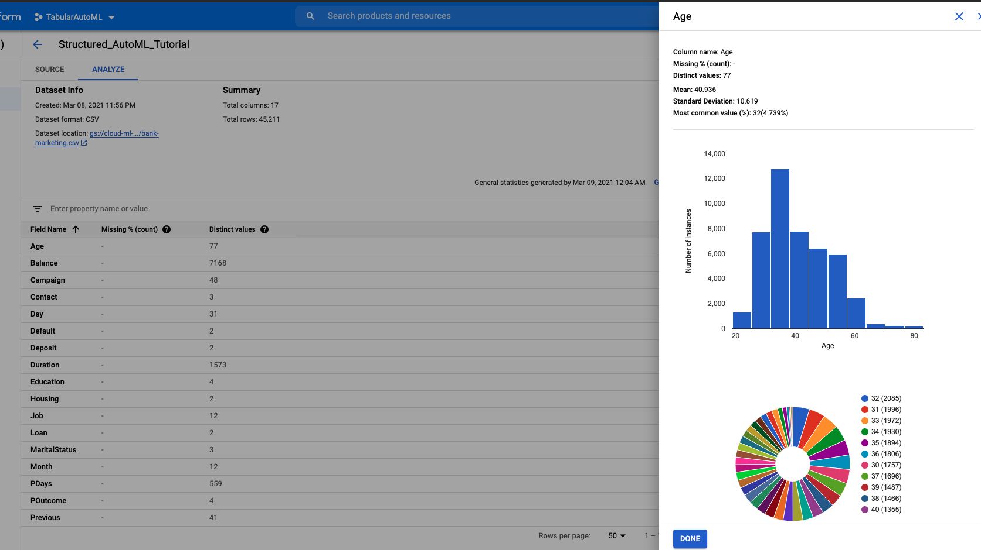
Data / statistics

Slide 28
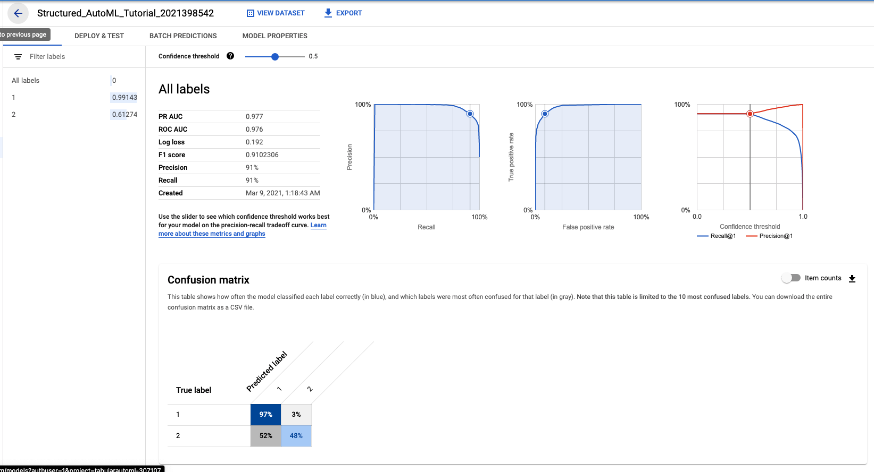
Model

Slide 29
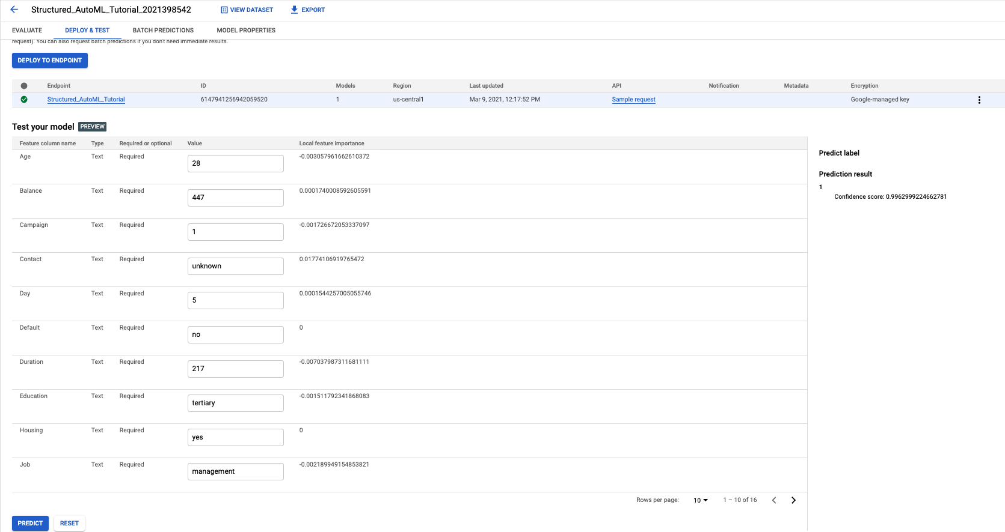
Test prediction

Slide 30
Part 2

Slide 31
Train and deploy on-device image classification model with AutoML Vision in ML Kit (Using Food images instead of Flowers)

Slide 32
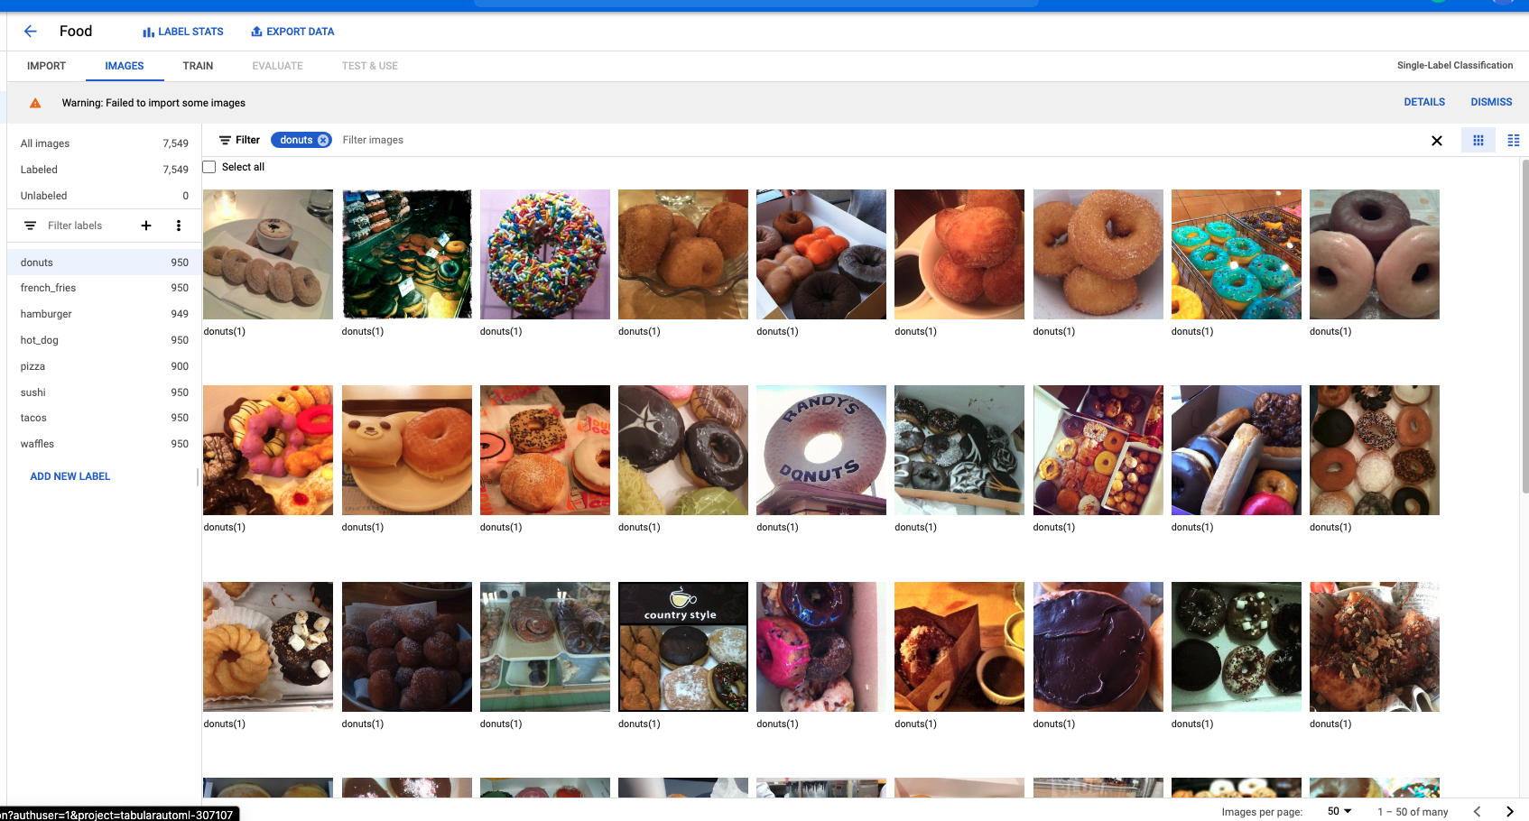
Food Data preparation

Slide 33
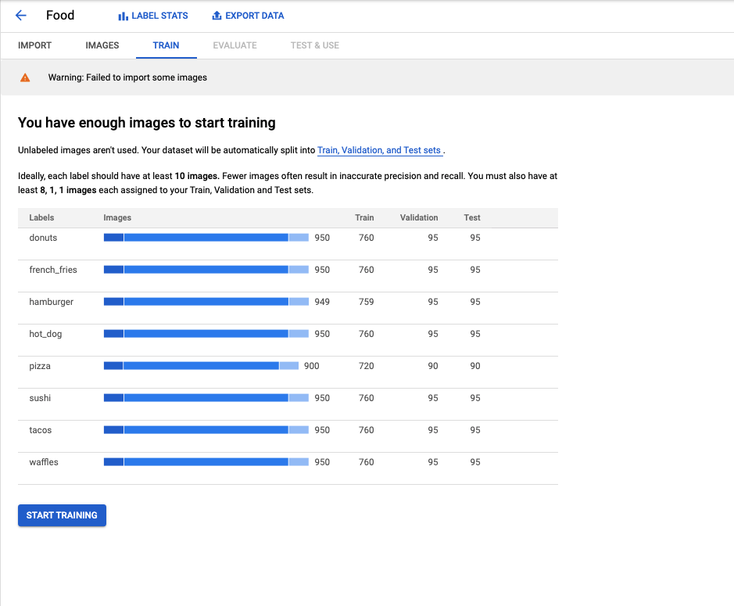
Training

Slide 34
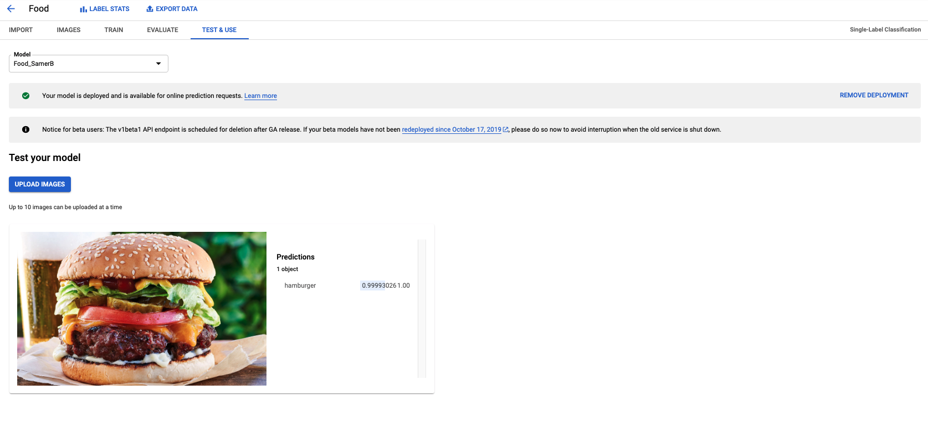
Test model

Slide 35
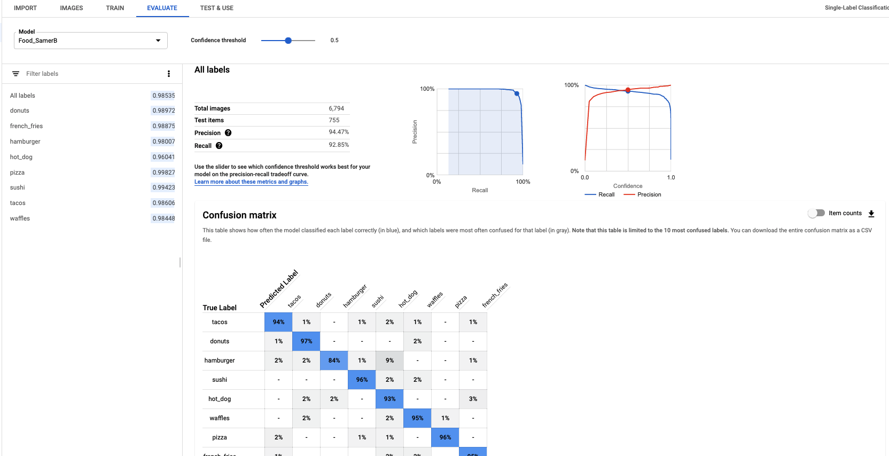
Evaluation

Slide 36
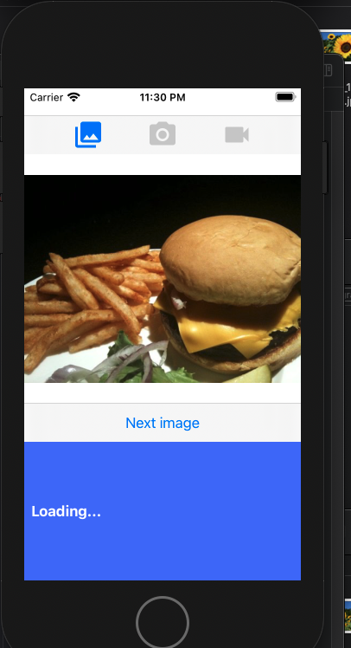
Deployment to app… with some errors

Slide 37
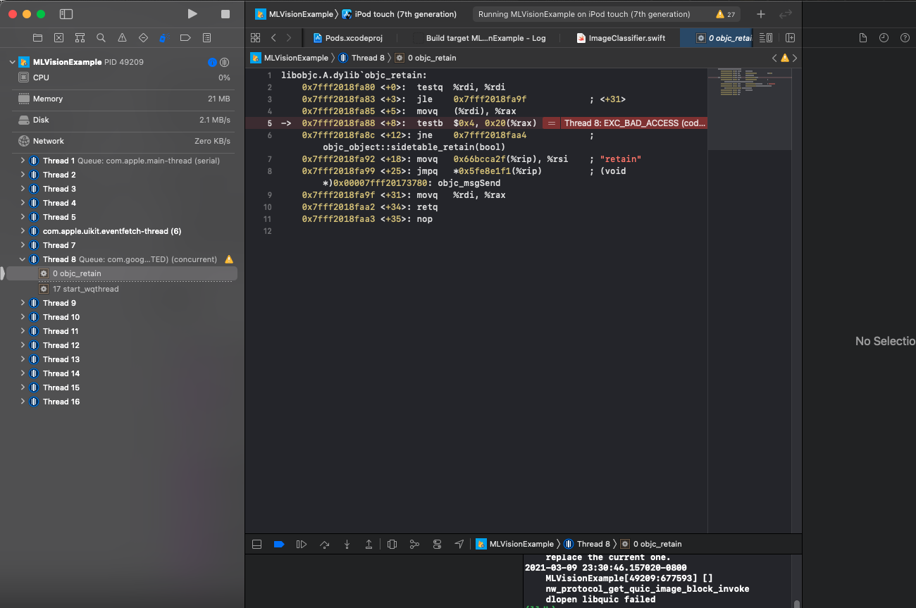
Couldn’t get past this No experience with Swift or app development in general made it hard to fix

Slide 38
Time Series Forecasting with the Cloud AI Platform and BQML

Slide 39
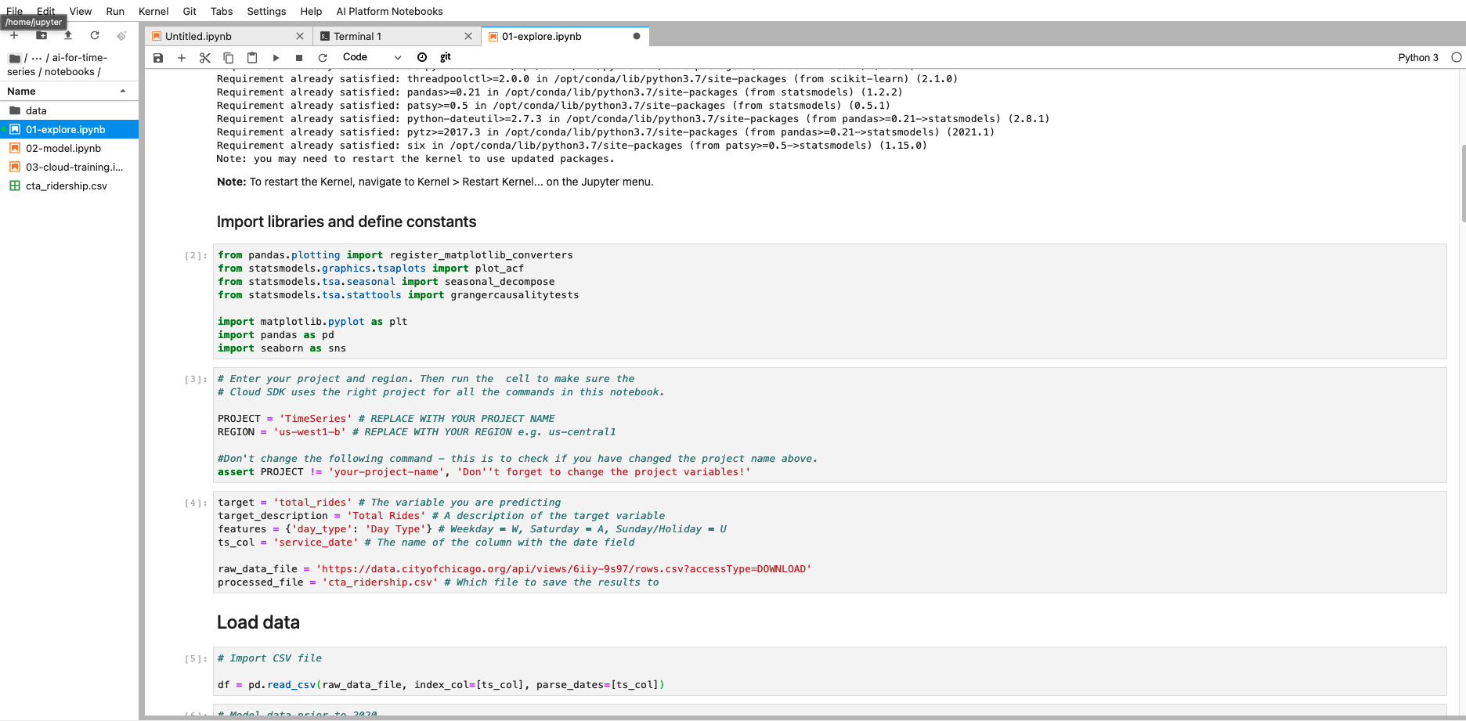
Running 01-explore.ipynb and creating the cta_ridership.csv file

Slide 40
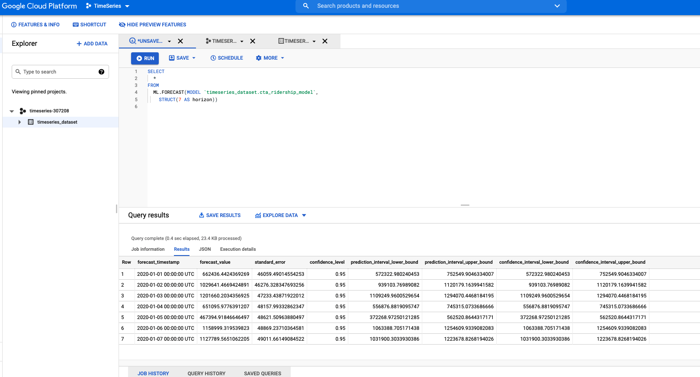
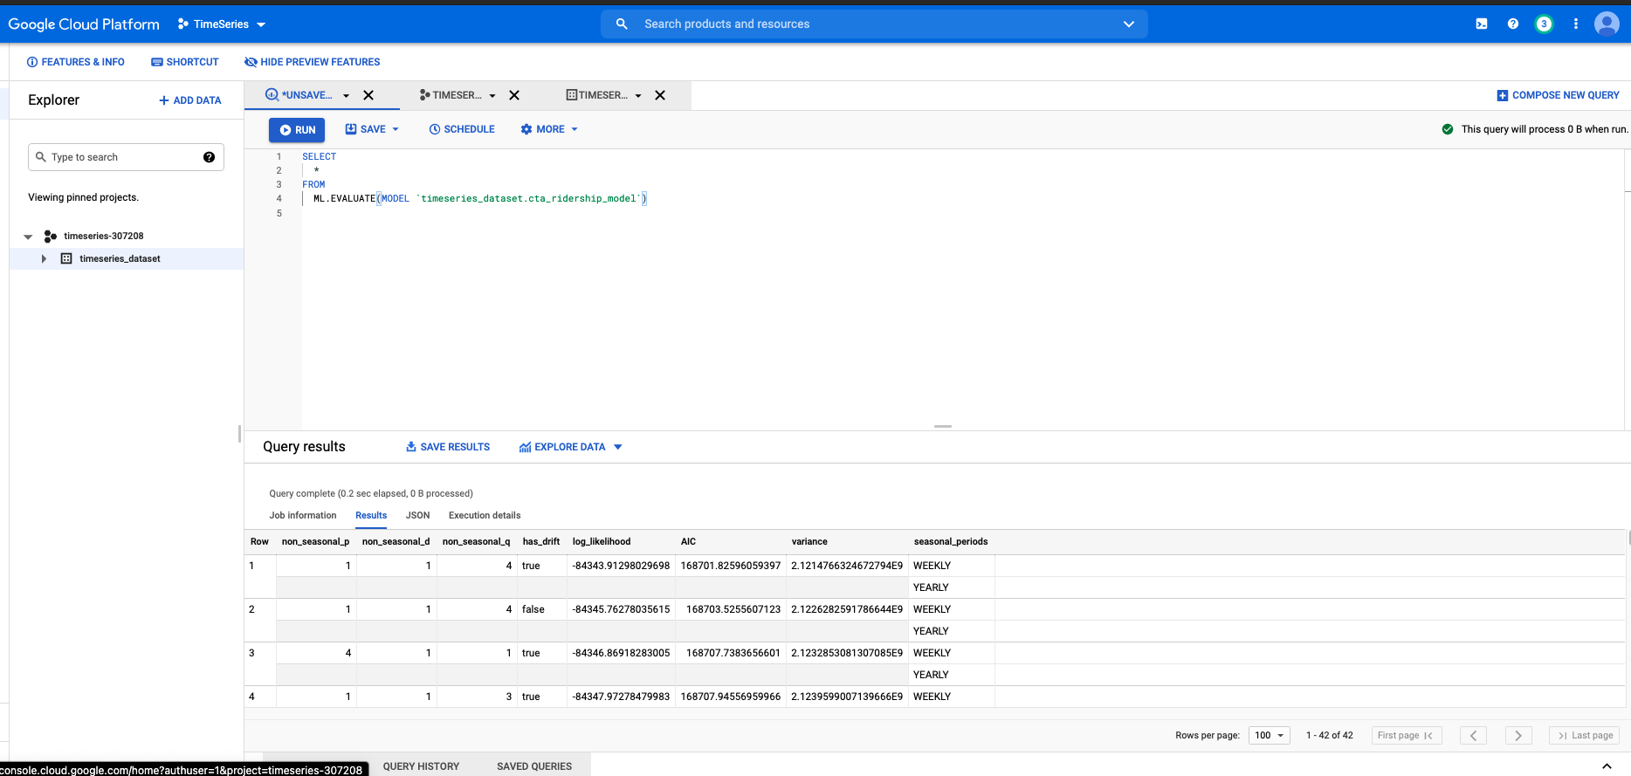
Utilizing BigQuery, screenshots of some queries, progress..

Slide 41
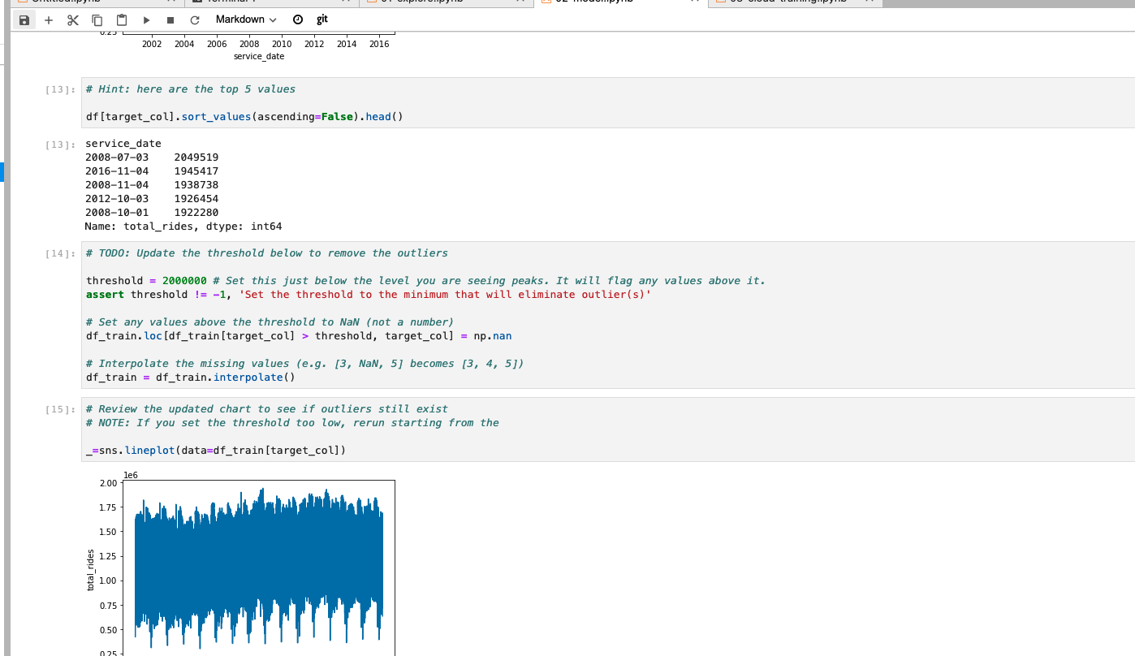
Building a Custom Forecasting Model (based on 02-model.ipynb)

Slide 42
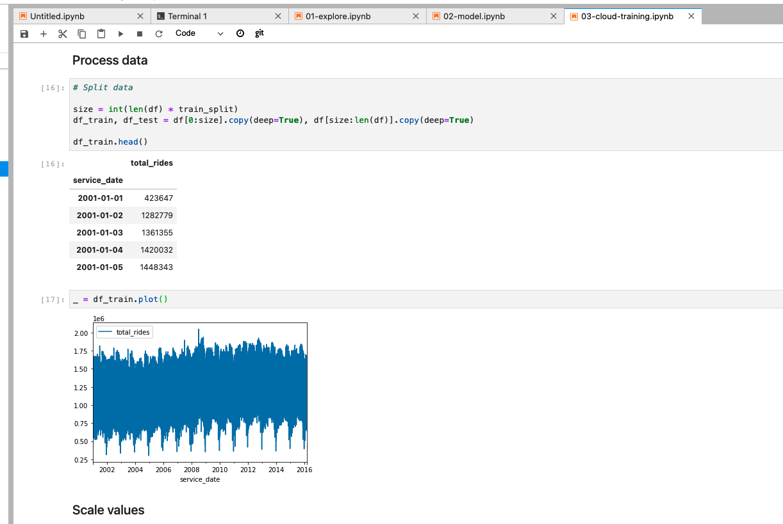
Train and Predict in the Cloud(03-cloud-training.ipynb)

